Slide 1
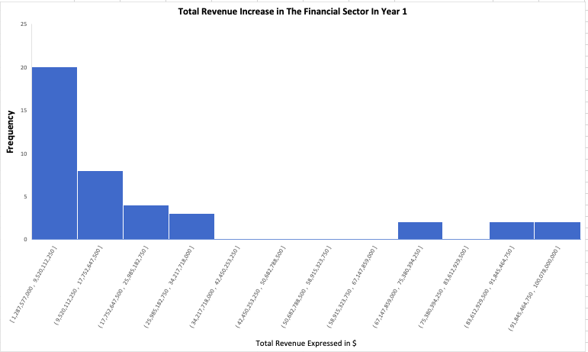
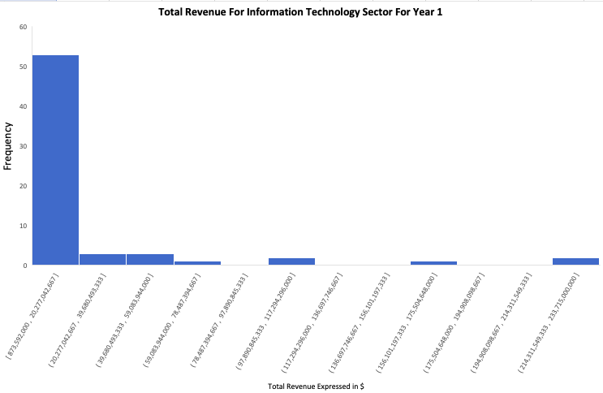
Does The Financial Sector have the similar Increase in Total Revenue than the IT sector for Year ?
Here are the histogram for the annual Total Revenue for Financial and IT sector companies reported for all companies in Year 1.
The mean total revenue for Financial is about $20 billion and for IT is above $15 billion, However the median for Financial is $10 billion and IT is $5 billion Its looks like companies in Financial sector is higher total revenue than IT sector , The standard deviation for Financial $26 billion in IT sector is $32 billion. That means the variability in IT sector total revenue is higher , with more companies generating above $130 billion revenue increase in Year 1 and more than 55% of The IT companies They earn revenue more than $5 billion.

